Slide 1

VACCINE DATA

Slide 2


Scope:
Overview
Data Understanding
Modelling
Modelling Results
Conclusions and Recommendations
Thank you

Slide 3

Overview
SEASONAL FLU (INFLUENZA)
A common viral infection that attacks the lungs, nose and throat. Young children, older adults, pregnant women and people with chronic disease or weak immune systems are at high risk. Flu can be deadly, especially in high-risk groups.
OBJECTIVE
The aim of the project was to build a model that can use the patient health and demographics data collected following the 2009 H1N1 virus outbreak to predict which patients are not likely to get the seasonal flu vaccine.

Slide 4
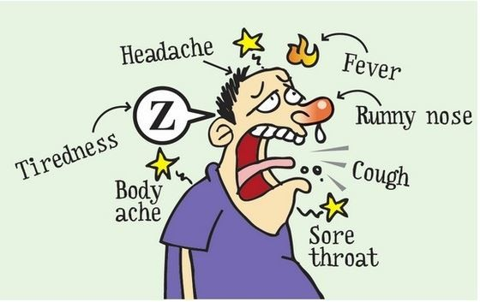
90%
Data Understanding
of the data collected was used.
All 38 data columns used were but the most significant were:
Opinion_seas_risk
Opinion_seas_vacc_effective
Doctor_recc_seasonal
Opinion_h1n1_risk
Opinion_h1n1_vacc_effective

Slide 5

Data Understanding
1.Opinion_seas_vacc_effective:
Opinion- Effectiveness of seasonal vaccine.
2. Opinion seas risk: Opinion:
Risk of getting sick with the seasonal flu without vaccine.
3. Doctor recc seasonal:
Seasonal flu vaccine was recommended by doctor.
4.Opinion_h1n1_vac_effective:
Opinion Effectiveness of h1n1 vaccine
5.Opinion_h1n1_risk:
Risk of getting sick with h1n1 flu without vaccine.

Slide 6
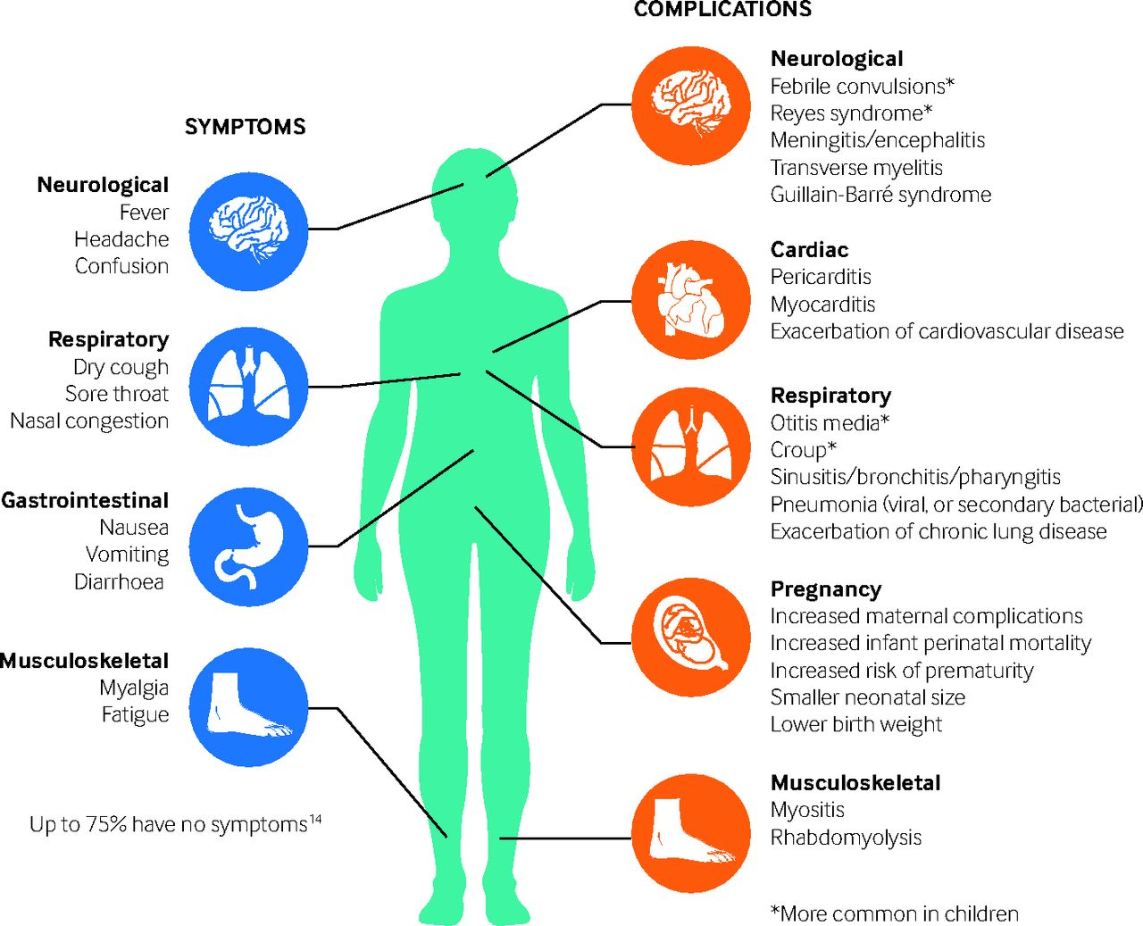
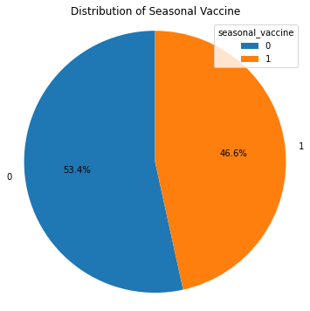
EXPLORATORY DATA ANALYSIS(EDA)

Slide 7
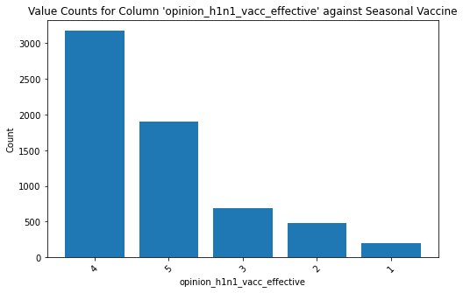
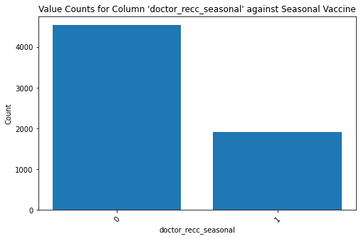
GRAPHS OF FEATURES AGAINST SEASONAL_VACCINE
.

Slide 8
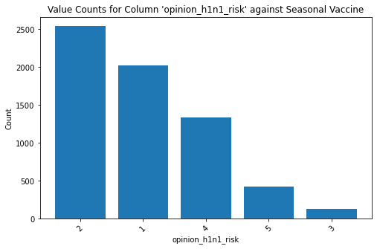
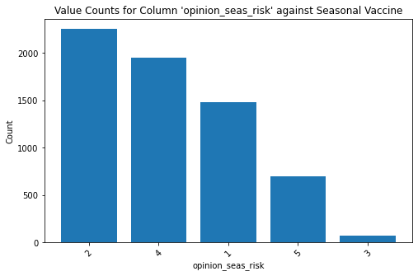
GRAPHS AGAINST SEASONAL_VACCINE

Slide 9
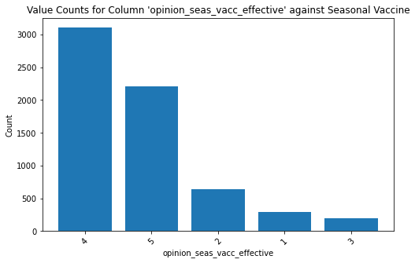
GRAPH AGAINST SEASONAL_VACCINE

Slide 10
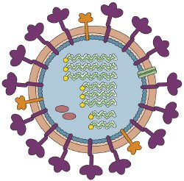
Modelling
MODELS USED:
1.DECISION TREE CLASSIFIER.
2.RANDOM FOREST CLASSIFIER.
3.K-NEAREST NEIGHBOR
4.GRADIENT BOOSTING

Slide 11
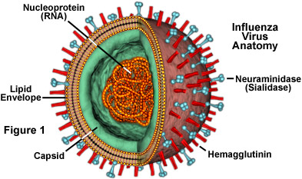
RANDOM FOREST RESULTS
SPECIFICITY:
0.84
ACCURACY:
0.81

Slide 12
Conclusion
Conclusion
The ML models developed for predicting vaccine non-uptake showed promising results, with a moderate accuracy of 78%, correctly identifying a substantial number of individuals who did not receive the seasonal flu vaccine. The models also highlighted several features that significantly influenced the likelihood of not receiving the vaccine.
‘Opinion seas risk' indicates individuals' perception of the risk associated with the seasonal flu, and ‘Opinion seas vac effective' reflects their belief in the effectiveness of the vaccine.
‘Doctor recc seasonal', represents whether individuals received a doctor's recommendation for the seasonal flu vaccine.
‘Opinion_h1n1_risk' captures individuals' perception of the risk associated with the H1N1 virus, while ‘Opinion_h1n1_vacc_effective' reflects their belief in the effectiveness of the H1N1 vaccine.

Slide 13
Recommendations.
Recommendations
1.Educate healthcare providers about recommending the seasonal flu vaccine during routine visits.
2. Emphasize the importance of vaccination for eligible individuals.
3.Conduct public health campaigns and Utilize social media to raise awareness about the benefits of the flu vaccine.
4.Provide training and resources to ensure up-to-date knowledge about the flu vaccine.
5.Stress the significance of recommending vaccination during routine check-ups.
6.Improve Vaccine Accessibility by expand vaccination sites in clinics, pharmacies, workplaces, and community centers.

Slide 14

Thanks!
Contact us:
oderataylor@gmail.com
Taylor Musa Odera,
P.O Box 785- 00100,
Nairobi.
contact@moringaschool.com

